Slide 1

Notes:
Introduce group members:
Adam
Prairie Rose
Mark

Slide 2
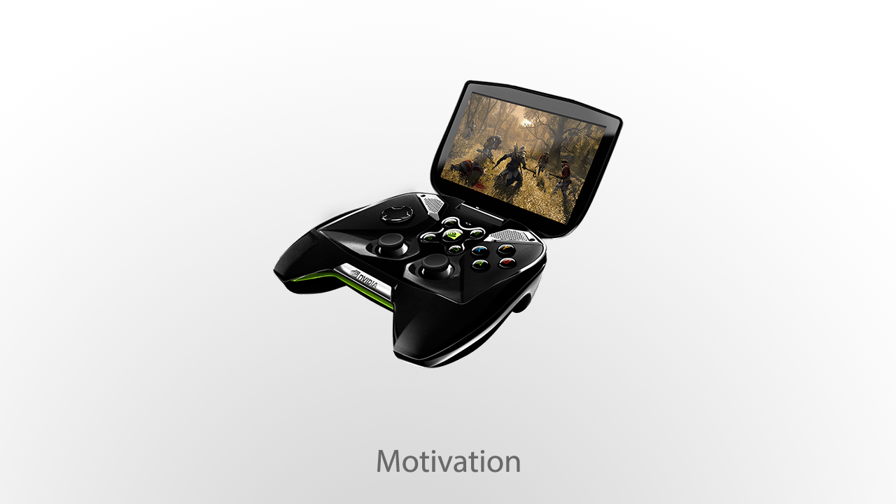
Notes:
Introduced at CES this year, the NVIDIA Shield – a Tegra 4 mobile device running Android Jellybean
GTX 680 desktop GPU can render to the device over a broadband network connection

Slide 3
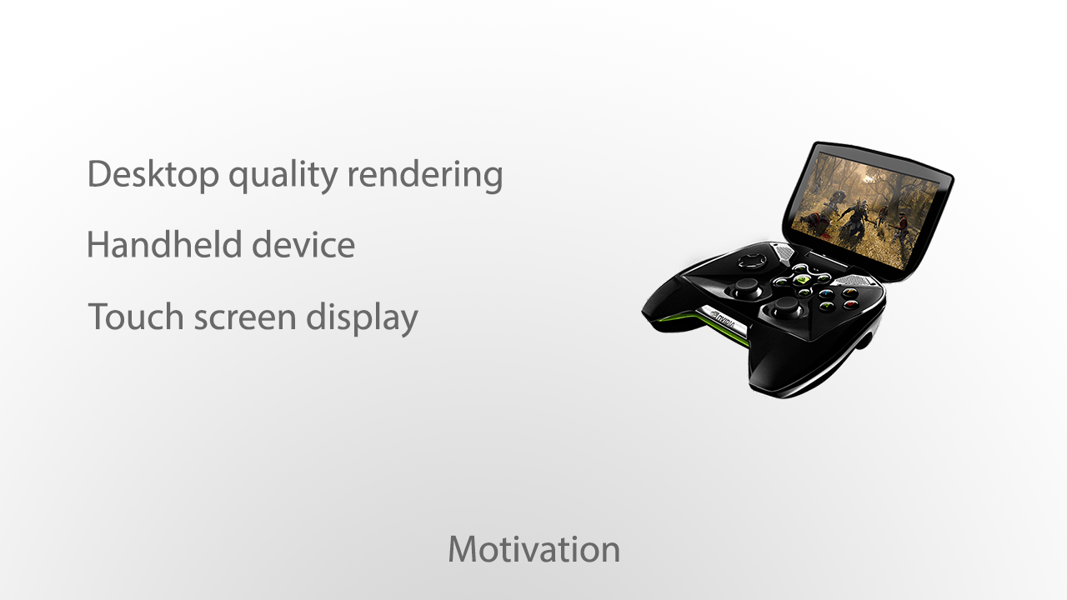
Notes:
Why is this device a good idea?
High quality graphics
Interesting control scheme between analog controller and touchscreen display

Slide 4
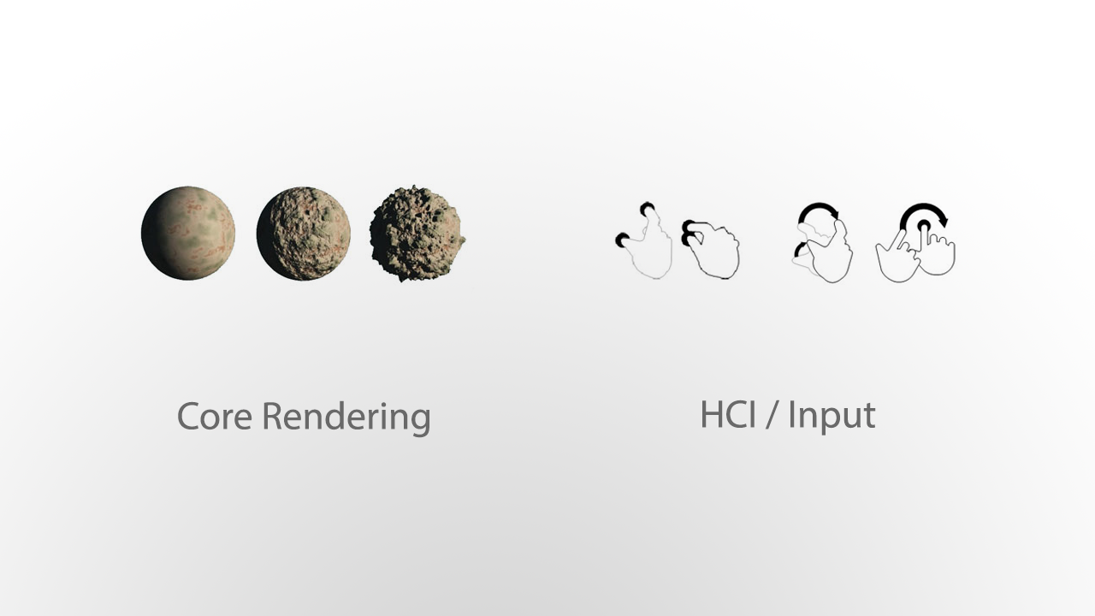
Notes:
Our project is broken down into two major components

Slide 5


Slide 6
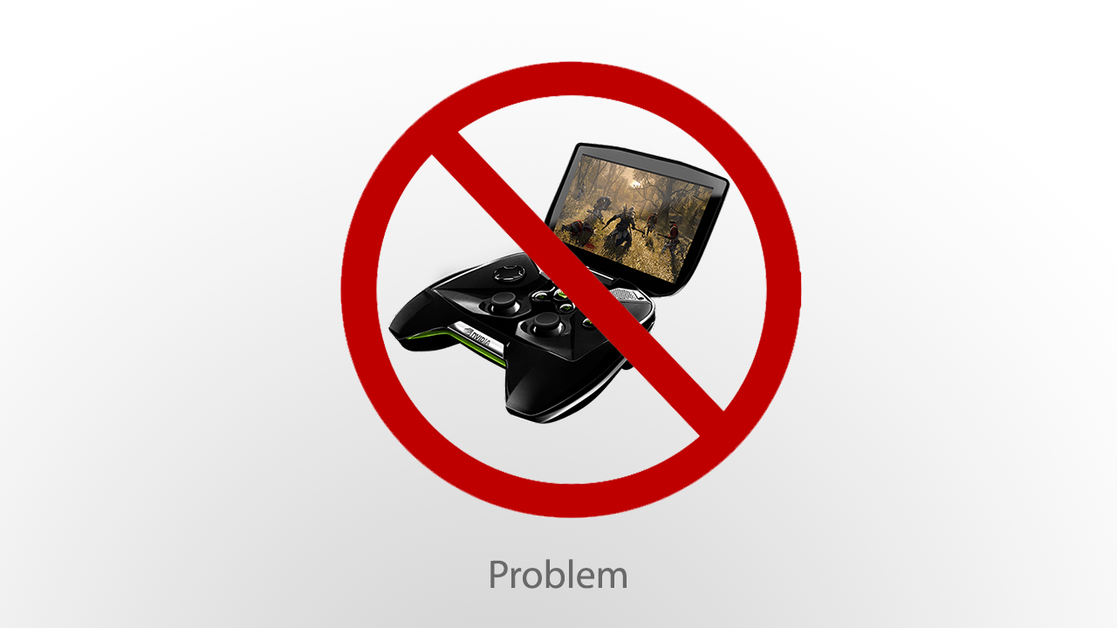
Notes:
NVIDIA hasn’t done a production run of the SHIELD yet, so we can get one ☹

Slide 7
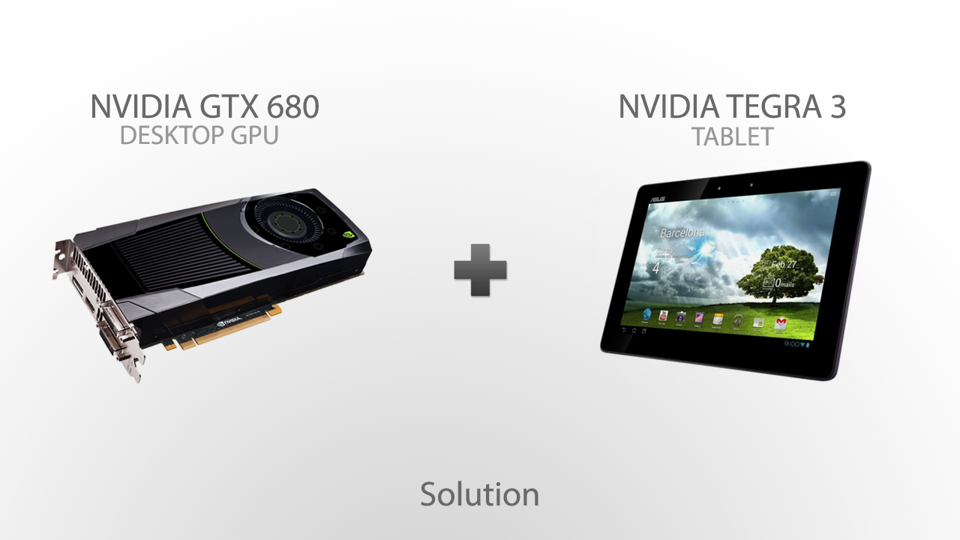
Notes:
Instead, we can do something similar…

Slide 8

Notes:
One we figured out the hardware solution, we started thinking about how we were going to create content.
There are a number of excellent engines and authoring tools out there, all of which are free for the type of product we are building.

Slide 9


Slide 10
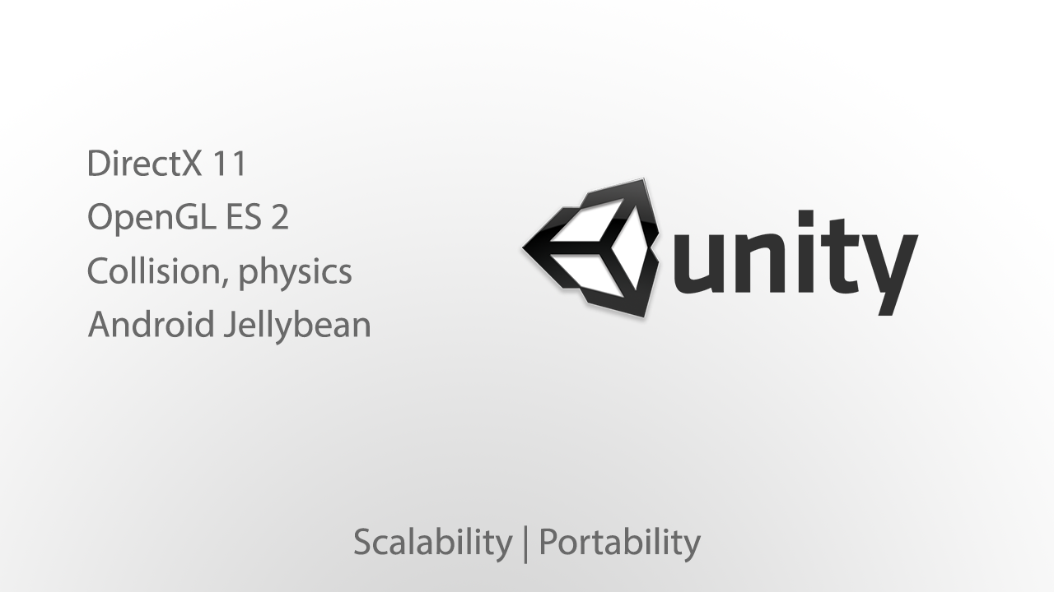

Slide 11

Notes:
We looked to current titles for inspiration

Slide 12
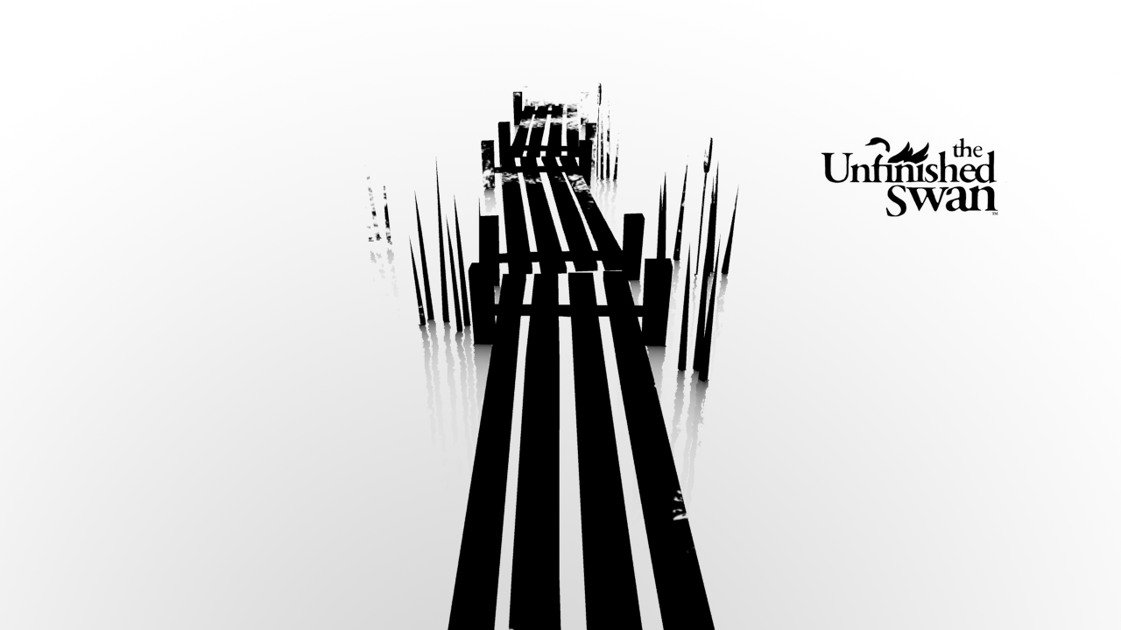
Notes:
A first person “splatter”.
Explore a 3D world throwing paint to reveal the shape of the world.

Slide 13
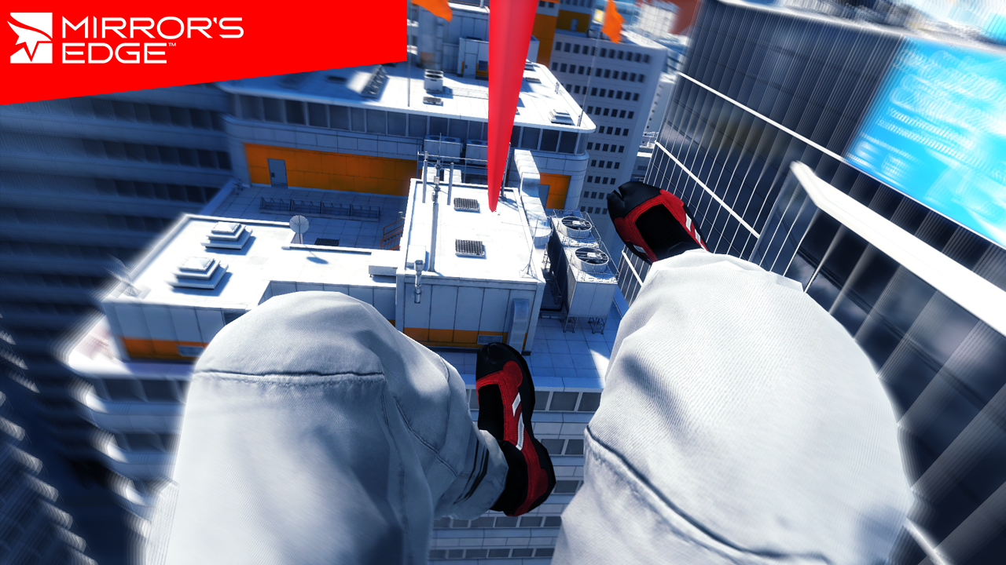
Notes:
A first person free-running parkour game.
Locked in a first person view for all actions in the game, including rolling, platforming, and sliding down zip lines.

Slide 14
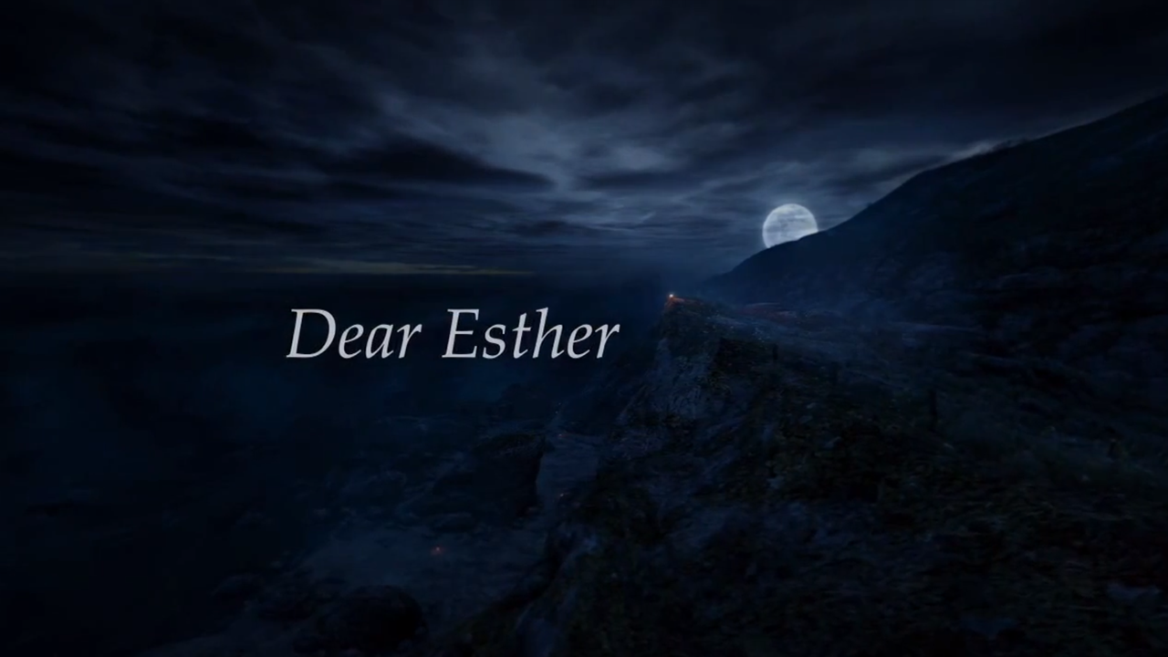
Notes:
Play trailer:
http://www.youtube.com/watch?v=D7VJ4lP-05A

Slide 15
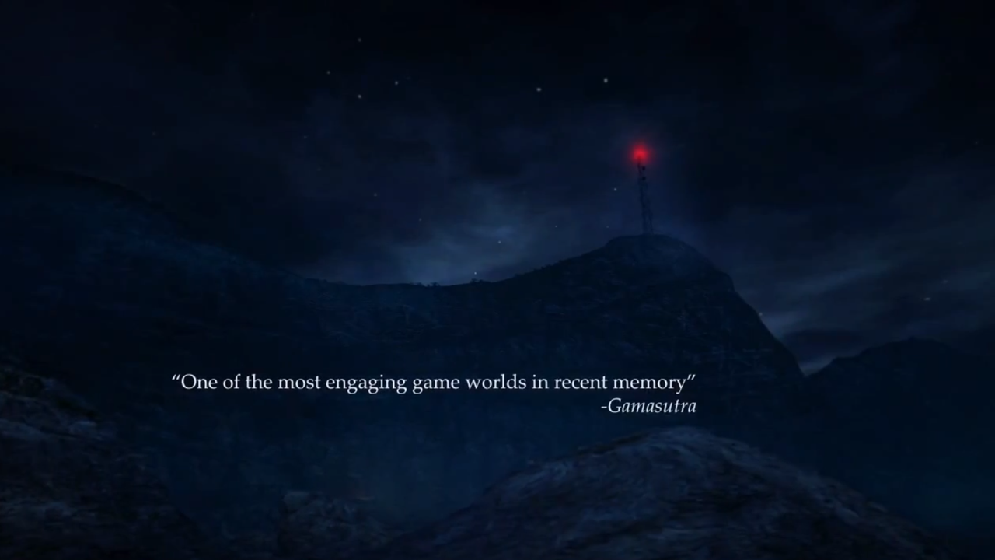
Notes:
Some contend that these games aren’t even games. When you don’t “do” anything, shoot anything, or solve a puzzle, is it really a “game”?
More importantly though, “does that even matter?”
These experiences are defining a new genre of interactive entertainment – and are becoming critically acclaimed in the process.

Slide 16
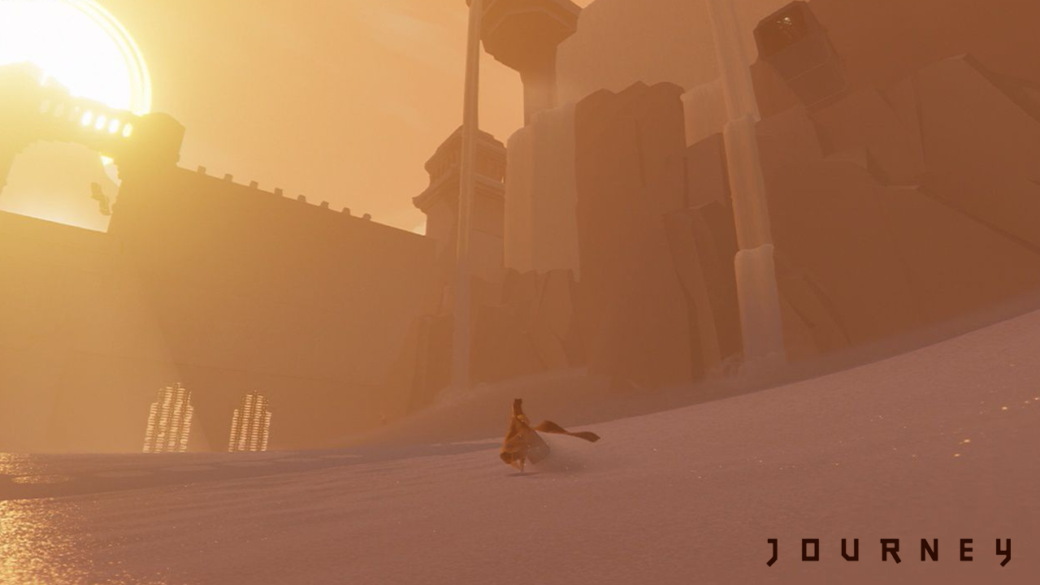
Notes:
Journey, released in March of 2012, won several Game of the Year awards – including 4 BAFTA (British Academy of Film and Television Arts)
In Journey, you explore a desert on your way up a mountain. You don’t solve any puzzles, shoot anything, platform, or kill anything. You walk and explore.
Yes, that’s it.

Slide 17
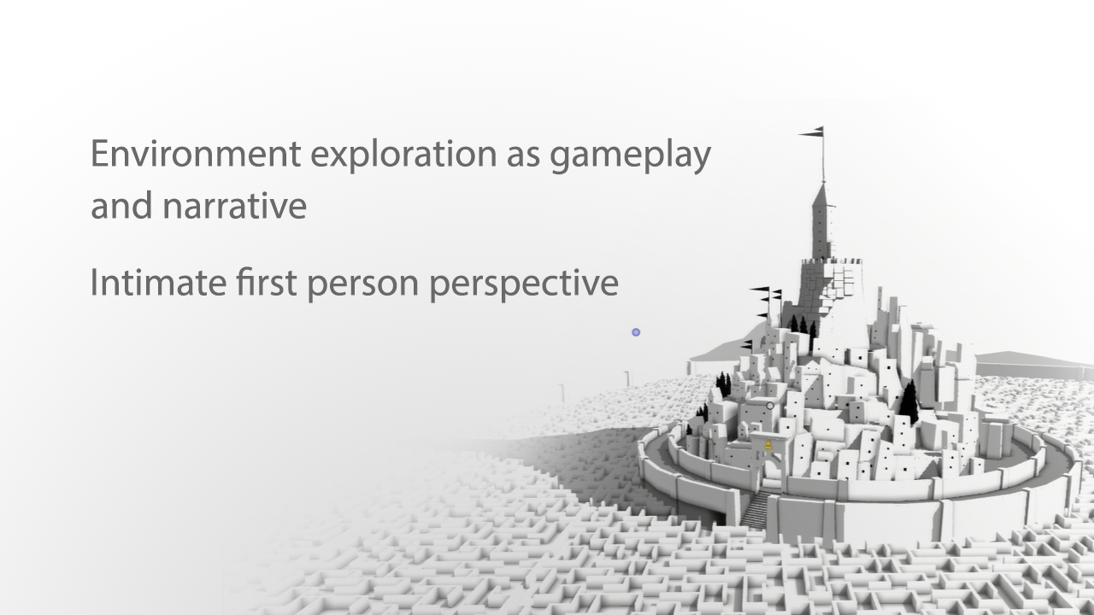
Notes:
So what can we take away from this?
Environmental exploration can exist as gameplay and narrative. This is inherently engaging without the need to shoot or kill things.
First person perspective gives this exploration an intimate and affecting feel.

Slide 18


Slide 19
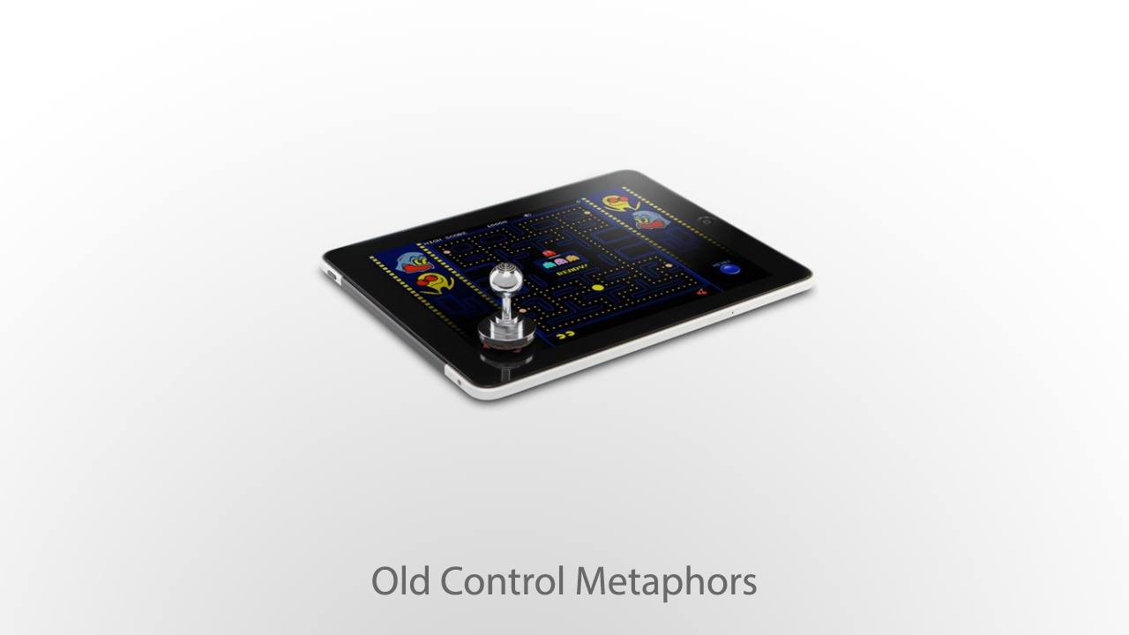
Notes:
Control metaphors touch devices are stuck around physical controllers.
We need new metaphors.

Slide 20
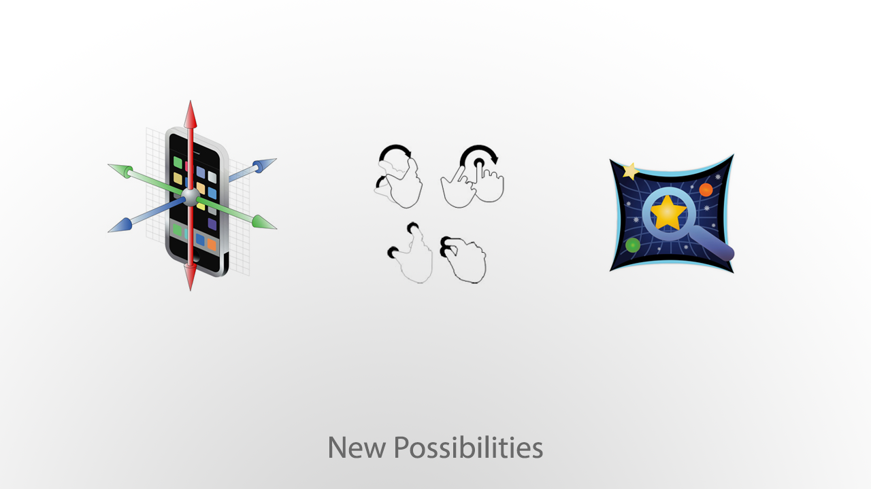
Notes:
Accelerometer, gestures, Google Skymap

Slide 21
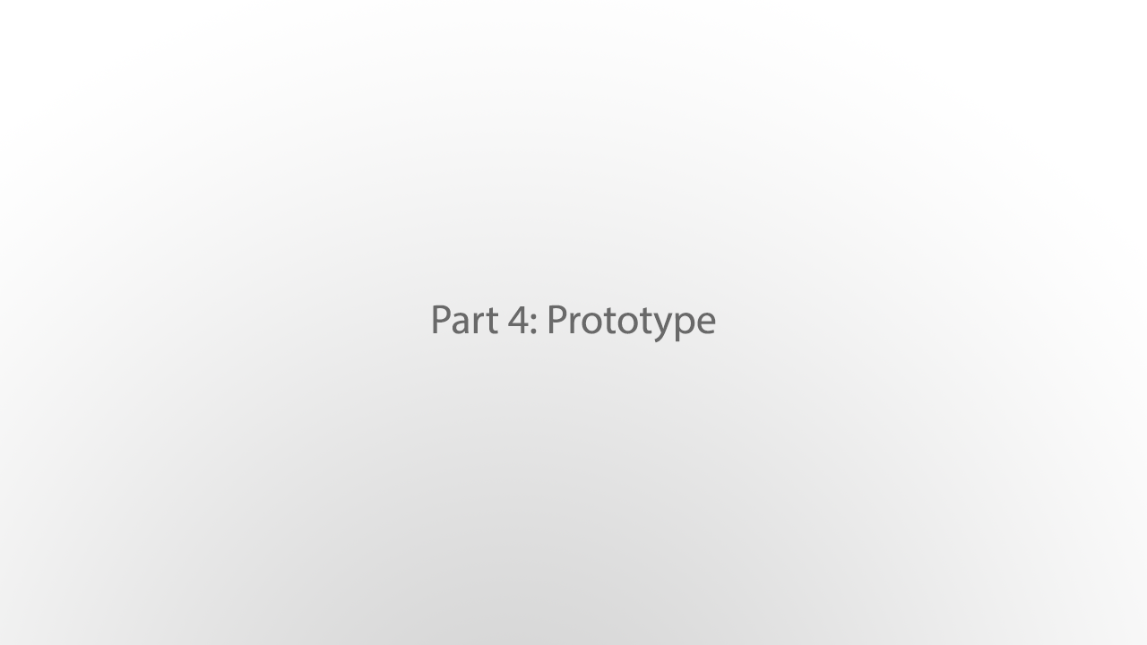

Slide 22


